Slide 1


SportSett:Basketball
A robust and maintainable dataset for Natural Language Generation
Craig Thomson, Ehud Reiter, Somayajulu Sripada
University of Aberdeen

Slide 2
The Rotowire Dataset / Task
Rotowire dataset by Wiseman et al. (2017)
Paired data and text:
Boxscore data
Human-authored sports summaries
In the order of 5000 games
Rotowire FG dataset by Wang (2019)
More games (about 7000)
Covers most of the 2014 through 2018 NBA seasons

Slide 3
Example Summary (about 1/3 of)
The Oklahoma City Thunder (25-24) defeated the New Orleans Pelicans (26-23) 102-91 on Wednesday at the Smoothie King Center in New Orleans. While the Thunder were down 57-51 at half, they had a huge second half where they out-scored the Pelicans 51-34, allowing them to steal a victory over the Pelicans. With Kevin Durant still sitting out with a toe injury, Russell Westbrook again took it on himself to do the bulk of the work offensively for the Thunder. Westbrook went 18-for-31 from the field and 2-for-6 from the three-point line to score a game-high of 45 points, while also adding six rebounds and six assists. It was his second 40-point outing in his last four games, a stretch where he's averaging 31 points, 7 rebounds and 7 assists per game. These two teams will play each other again on Friday in Oklahoma.

Slide 4
Example Summary (about 1/3 of)
The Oklahoma City Thunder (25-24) defeated the New Orleans Pelicans (26-23) 102-91 on Wednesday at the Smoothie King Center in New Orleans. While the Thunder were down 57-51 at half, they had a huge second half where they out-scored the Pelicans 51-34, allowing them to steal a victory over the Pelicans. With Kevin Durant still sitting out with a toe injury, Russell Westbrook again took it on himself to do the bulk of the work offensively for the Thunder. Westbrook went 18-for-31 from the field and 2-for-6 from the three-point line to score a game-high of 45 points, while also adding six rebounds and six assists. It was his second 40-point outing in his last four games, a stretch where he's averaging 31 points, 7 rebounds and 7 assists per game. These two teams will play each other again on Friday in Oklahoma.

Slide 5
Example Summary (about 1/3 of)
The Oklahoma City Thunder (25-24) defeated the New Orleans Pelicans (26-23) 102-91 on Wednesday at the Smoothie King Center in New Orleans. While the Thunder were down 57-51 at half, they had a huge second half where they out-scored the Pelicans 51-34, allowing them to steal a victory over the Pelicans. With Kevin Durant still sitting out with a toe injury, Russell Westbrook again took it on himself to do the bulk of the work offensively for the Thunder. Westbrook went 18-for-31 from the field and 2-for-6 from the three-point line to score a game-high of 45 points, while also adding six rebounds and six assists. It was his second 40-point outing in his last four games, a stretch where he's averaging 31 points, 7 rebounds and 7 assists per game. These two teams will play each other again on Friday in Oklahoma.

Slide 6
Example Summary (about 1/3 of)
The Oklahoma City Thunder (25-24) defeated the New Orleans Pelicans (26-23) 102-91 on Wednesday at the Smoothie King Center in New Orleans. While the Thunder were down 57-51 at half, they had a huge second half where they out-scored the Pelicans 51-34, allowing them to steal a victory over the Pelicans. With Kevin Durant still sitting out with a toe injury, Russell Westbrook again took it on himself to do the bulk of the work offensively for the Thunder. Westbrook went 18-for-31 from the field and 2-for-6 from the three-point line to score a game-high of 45 points, while also adding six rebounds and six assists. It was his second 40-point outing in his last four games, a stretch where he's averaging 31 points, 7 rebounds and 7 assists per game. These two teams will play each other again on Friday in Oklahoma.

Slide 7
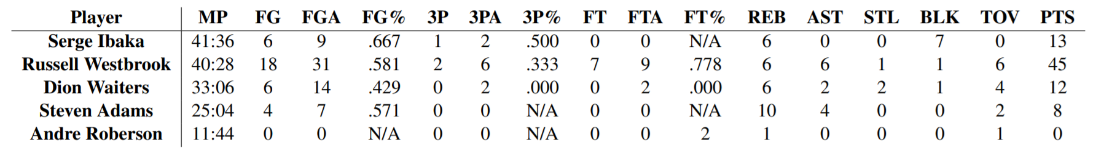
Example Boxscore (part)
Each team has up to 13 players
Also included in Rotowire data:
Team totals and percentages
Points total for each team in 4 game periods

Slide 8
Generating Sport Summaries
Realistic
Paragraph with a narrative:
~10-15 sentences
~300 words
Beginning, middle, and end
Statistic / data focused
Difficult
Lengthy text to generate (many tokens)
Complex information in both data and text

Slide 9
What is missing from ROTOWIRE and How can the Dataset be improved?

Slide 10
What is missing from the input data?
Facts in the human-authored summaries are often not present in the data
In the same form
In any form
There is a known structure to the league and season, which is not present in the data.
Missing common attributes such as location, stadium, and day of week

Slide 11
The event Structure
“The Oklahoma City Thunder (25-24) defeated the New Orleans Pelicans (26-23) 102-91 on Wednesday at the Smoothie King Center in New Orleans.”
“These two teams will play each other again on Friday in Oklahoma.”
Systems need access to previous game data, as well as the schedule for each team in order to generate such sentences.

Slide 12
PREVIOUS AND UPCOMING GAMES
“It was his second 40-point outing in his last four games, a stretch where he's averaging 31 points, 7 rebounds and 7 assists per game.”
Talking about how a player has done over a sequence if games is common in these summaries.
Set aside whether systems can perform this operation, the data has to be there in the first place!

Slide 13
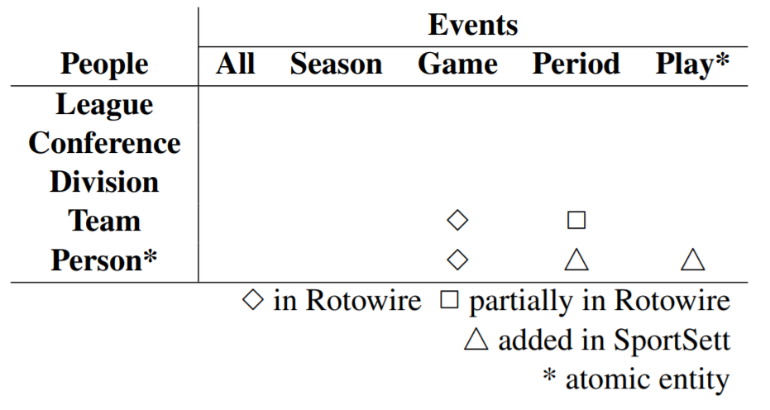
Events and People
These stories are about people in events
Known
Structured
Mostly static
People and Event hierarchy

Slide 14
SportSett:Basketball
Relational Database (PostgreSQL)
ORM (in Ruby)
2014 through 2018 seasons (35 / 6150 games missing text)
Person & Event hierarchy
Backwards compatability
Sources: Rotowire, Wikipedia, Basketball Reference.

Slide 15
Investigation

Slide 16
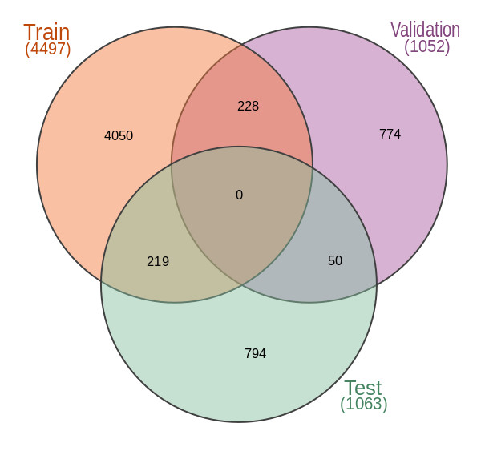
Partition Contamination
Data is needed from previous / subsequent games
There can be multiple summaries per game
We should not use training data to generate
Switch to partition by season
Not perfect
Better than random
Can still cross-validate
Contamination in Rotowire / FG

Slide 17
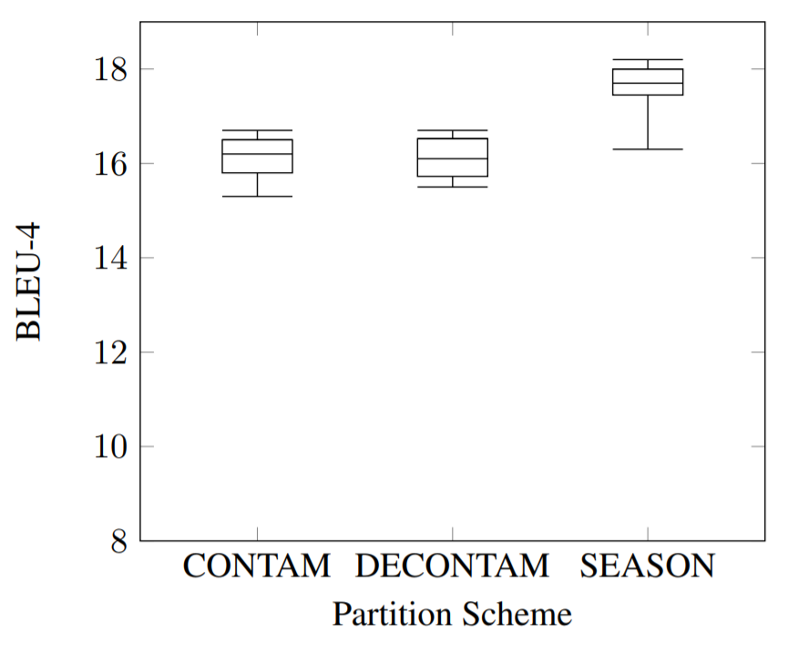
Partition schemes and metrics
Trained model:
as per Rebuffel et al. (2020)
Three partition schemes
BLEU
Not the best metric
Curious finding for SEASON
Other metrics
RG, CS, CO, all need evaluated
Human evaluation
BLEU score on different partition schemes

Slide 18
Still more that can be done
Some discrepancies between game and play-by-play statistics
Likely human error at source
Can be partially auto-resolved
Which subset of data should be included by systems?
Raw vs derived data?
“It was his second 40-point outing in his last four games”
Playoff and Preseason
We should continue to revise and improve the task

Slide 19
Thank you!
QuestionS?
c.thomson@abdn.ac.uk
https://github.com/nlgcat/sport_sett_basketball

